Slide 1
ALPHA PHI OMEGA
SPRIng Semester 2012
Notes:
apo@lists.iwu.edu, link for apo database

Slide 2
VP Community: Michelle Moon email: apo.oe.community@gmail.com
Clarehouse - Thursday, April 12
11:15am-1:30pm
Washington School Carnival - Friday, April 13
6pm-8pm
Spring Carnival at Stevenson Elementary School - Saturday, April 14
Running games, helping with refreshments, helping with line control for the Zoo Lady, and helping sell tickets.
Children's Home + Aid 5K - Sunday, April 15
Tipton Park: 2410 G.E. Road, Bloomington, IL
Register on http://volunteertoendchildabuse-esearch.eventbrite.com/?srnk=3
Directing runners where to go on the course - 1:45-4pm
Helping with children's activities - little before 1pm-2pm

Slide 3
VP Fellowship: Vicki Simmons email: apo.oe.fellowship@gmail.com
Passover Seder: Wednesday, 4/11 at 6:30
Ice cream at Coldstone: Thursday, 4/12 at 7:3o
Undercover XX: Friday, 4/13 at 8

Slide 4
Treasurer: Ben Gesensway email: apo.oe.treasurer@gmail.com
Carwash online Supplies
Carwash posters

Slide 5
VP Membership: Katherine Henning email: apo.oe.membership@gmail.com
All hours for this semester MUST be in by Reading Day (and please try to do that before then)
Please turn in your notes before you leave
Birthdays: Marissa DeWeese- April 4th

Slide 6
Meet Your Brothers
Kaitlyn Eichinger
Her mom and her boyfriend’s mom shared a room in the hospital after they were both born
Kristen Fredrickson
Has read Gone with the Wind 9 times!
Favorite animal is the penguin

Slide 7
Meet Your Brothers
Thomas Simmons
Plays the saxophone
Favorite animal is the platypus
Alyssa Shannon
Has been to both London and Paris
Her favorite movie is A Walk to Remember

Slide 8
Meet Your Brothers
Kristy Lazicki
Only had 3 wisdom teeth
Favorite animal is the bear
Hayley Harroun
Went to Morocco this summer
Likes horseback riding

Slide 9
Meet Your Brothers
Daniel Maurer
Likes Harry Potter
Enjoys psychology and biopsychology

Slide 10
Appointed Positions:
Student Senate Liaison - Sarah Bergman
Chaplain - Daniel Maurer
Historian - Kaitlyn Eichinger
Alumni Chair - Tiara Thomas
Webmaster - Thomas Simmons
Leadership Chair - Hayley Harroun
Section 50 Service Project Chair – Emily Schmidt

Slide 11
Old Business

Slide 12
New Business

Slide 13
News or Announcements

Slide 14
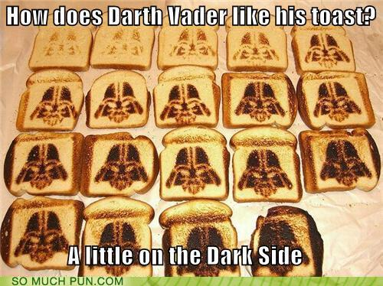
TOAST SONG!!

