Slide 1
ALPHA PHI OMEGA
SPRIng Semester 2012
Notes:
apo@lists.iwu.edu, link for apo database

Slide 2
President: Carly Wilson email: apo.oe.president@gmail.com
CAPS
Next Tuesday, Mandatory Meeting
*Please return your Chapter evaluation sheet
APO LEADS Day
This Saturday,U of I, 12:00 - 4:30 PM
Leave CNS 11:00 AM
Fellowship following LEADS Day
More Information: https://docs.google.com/spreadsheet/viewform?formkey=dFUzX2d2RkZ3aXMwbHZXSjJaWVQ3WFE6MA
Webinar
Matching Volunteers with needs - Wednesday February 29, 8 PM
Tri-Sectionals
April 20 - 22, Loyola University
More Information: https://docs.google.com/open?id=0B9G4lfIn2TkQNjEyMGE1YjctZGU4Mi00ZjVkLWE3N2MtNTAxM2E4NzU0NWNm

Slide 3
President: Carly Wilson email: apo.oe.president@gmail.com
Awards
Distinguished Service Certificate
- Given to any brother or advisor who is in good standing, and has exemplified exceptional service to the chapter, community, campus, or nation
- Must have pledged Spring 2011 or before
- Maximum of 10 recipients
- Must be approved by 1/2 of the chapter
Distinguished Service Key
- Very prestigious award given to any senior member or advisor of the Omega Epsilon Chapter of Alpha Phi Omega who is in good standing and has gone above and beyond the normal requirements of service to the chapter, and exemplifies the three Cardinal principles to the highest degree.
- One recipient each semester
- Must be approved by 4/5 of the chapter
Please send the name of each individual that you would like to nominate and a brief description (2-3 sentences) of why you believe they are deserving of the award to apo.oe.president@gmail.com by 5:00 PM Friday, March 9. The descriptions will be shown on the ballot and we will vote on Tuesday, March 20.
** More awards to come!

Slide 4
VP Community: Michelle Moon email: apo.oe.community@gmail.com
How was the Chess Tournament??
Day of Dance - Sat, Feb 25
You should have gotten an email with your job. Let me know if you have any questions.
Miller Park Zoo - Sat, March 3
They contacted us with a special need for flaggers.
Children's Home + Aid 5K - April 15th
http://volunteertoendchildabuse-esearch.eventbrite.com/?srnk=3
Sign up to help out on the link above.
Email me or Chelsea Werries at cwerries@iwu.edu in you have any questions
Humane Society
Doodle: http://www.doodle.com/5aeytzmc5dw36kmk
One-on-one computer lesson volunteer to help Evergreen Village residents with their computer skills

Slide 5
VP Campus, National & Frat.: Ronnie Watson email: apo.oe.cnf@gmail.com
Tu Universidad?
Green Out Basketball??
Pulseras?
Staff Night Out - look out for my email Friday morning
Special Olympics Polar Plunge Feb 25th
Habitat for Humanity build March 3rd
Habitat Restore March 3rd
8-12 and 12-4
20 people tops per shift
only need to dress warm; we'll fill out paperwork there
Events that Lock/Close early
Completing Events

Slide 6
VP Fellowship: Vicki Simmons email: apo.oe.fellowship@gmail.com
Open Skate: This Friday (2/24) - SIGN UP!
Oscars party: This Sunday (2/26) - snacks at 5, Oscars at 6 - there will be PRIZES
Fusion Brew & Study Tables: March 4th
Bowling: 3/7
Pilates: 3/21
Formal: 3/24
Undercover XX: 4/13
Theme for formal (vote for one):
casino pirates 1920s

Slide 7
Treasurer: Ben Gesensway email: apo.oe.treasurer@gmail.com
Making dolls
March 2nd: 6 - 8 pm (or whenever people finish)
March 3rd: 2 - 5 pm
Selling dolls
March 5 - 9: 11 - 2pm in CNS atrium
Selling pizza on the quad
March 30: 11 - 1 am

Slide 8
Pledge Educator: Liz Kuehn email: apo.oe.pledge@gmail.com
Congratulations to our Pledge Class Appointed Positions!!
President
Hilary Charlet
VP Service
Carissa Ball
VP Fellowship
Mallory Brooks
Pledge meetings are held in CNS C102 at 8pm on Tuesdays and actives need to come to at least one meeting
Pledges start sending your hours (service, fellowship, and leadership points) to Tim-- tborchar@iwu.edu
Pledge Parents please see me after the meeting

Slide 9
VP Membership: Katherine Henning email: apo.oe.membership@gmail.com
Reminders:
We are docking hours for missing your events. Actives AND pledges
Leadership points and hours for pledges go to my assistant, Tim Borchardt: tborchar@iwu.edu
If you do not complete your event coordinator duties, we will not dock leadership points.
Leadership points for actives go to me.
Start sending your hours in!
Birthdays! Claudia Petcu –February 14th

Slide 10
Meet Your Brothers
Anne Fritsch
Studied abroad in London
Enjoys music and reading
Liz Kuehn
Studied abroad in Australia and enjoyed feeding her host mother's chickens

Slide 11
Meet Your Brothers
Edrienne Besagar
Used to think reindeer were fictional animals, like unicorns.
Favorite T.V. shows include Lost and The Big Bang Theory
Leslie Ramirez
Backpacked across Europe in 2010, starting in Copenhagen and ending in London.

Slide 12
Meet Your Brothers
Katelyn McDonald
Has a fainting goat
Can knit
Bones and Lost are two of her favorite T.V. shows.
Melissa Graffy
Is related to Benedict Arnold’s mother
Pet a squirrel in London

Slide 13
Meet Your Brothers
Iyinogooluwa Ajayi
Favorite animal is the lion
Enjoys watching movies
Emma Craig
Owns a horse (named Kay)
Is the shortest person in her family despite being a middle child

Slide 14
VP Communications: Lindsay Bow email: apo.oe.communications@gmail.com
Google Poll about T-shirts, etc.
Don’t forget to do your event coordinator duties!!

Slide 15
Appointed Positions:
Student Senate Liaison - Sarah Bergman
Chaplain - Daniel Maurer
Historian - Kaitlyn Eichinger
Alumni Chair - Tiara Thomas
Webmaster - Thomas Simmons
Leadership Chair - Hayley Harroun

Slide 16
Old Business

Slide 17
New Business
Voting Delegates for Tri-Sectionals
Refund for Rush Week supplies

Slide 18
News or Announcements

Slide 19
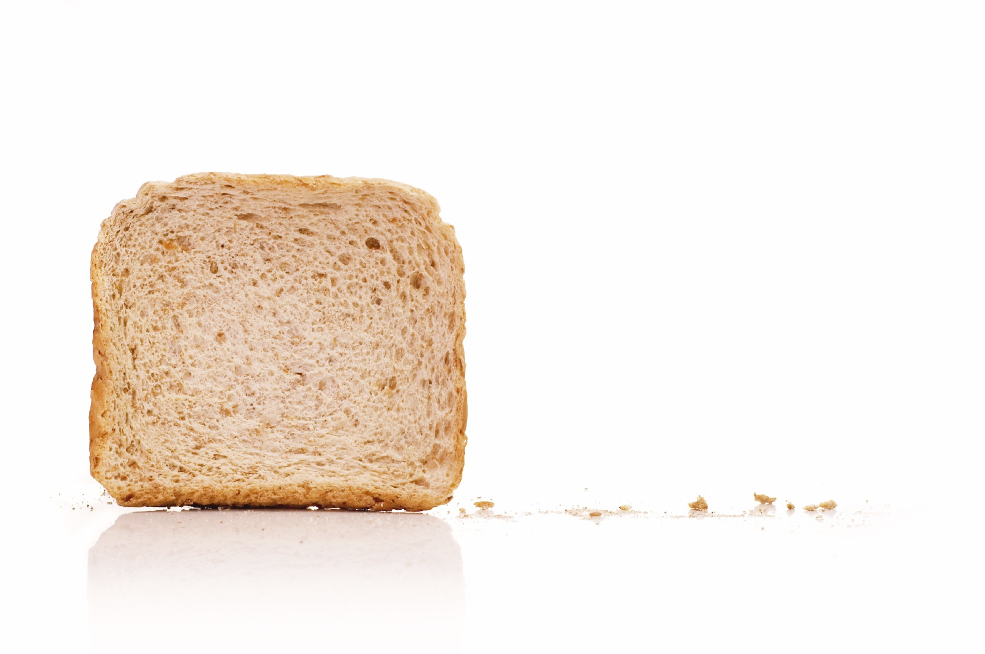
TOAST SONG!!

