Slide 1
ALPHA PHI OMEGA
SPRIng Semester 2012
Notes:
apo@lists.iwu.edu, link for apo database

Slide 2
President: Carly Wilson email: apo.oe.president@gmail.com
Christy - Robert's Rules
Committee Updates
-Rush Week – NOW! :)
-Last day to turn in dues – TODAY!!!!
-Pledge Ceremony/Pledge Parent Reveal – February 7, Davidson Room
-Leadership Day – February 26, Location TBD
-CAPS – February 28
-Spring Break – March 10-18, No Meeting
-Formal – March 24
-Nominations Begin – March 27
-Section 50 Service Day – March 31
-Initiation – April 3, Davidson Room
-Elections – April 10
-Changeover, Last meeting – April 17
-Section 47/50/51 Conference - April 20-22

Slide 3
VP Community: Michelle Moon email: apo.oe.community@gmail.com
Humane Society Orientation - Feb 7, 21, 27 - 5:30pm-7:30pm
Really Really Free Market-Sundays Feb 5, 19 12-3pm
Putt with the Prose
Sat., Feb 11 - set up at 5pm
Sun., Feb 12 - take down at 5pm
IESA Chess Tournament
Fri., Feb 17 - 11am-1pm, 2pm-5:30pm
Sat., Feb 18 - 8:30am-12pm, 1pm-4:30pm
Day of Dance - Sat., Feb 25
Hand out Valentine's Day Cards at Evergreen Village

Slide 4
VP Campus, National & Frat.: Ronnie Watson email: apo.oe.cnf@gmail.com
How was the Special Olympics tournament?
ALD Blanket Bash this Thursday 7:30pm
Pulseras Sale - Feb. 13-17 (?)
More coming soon...

Slide 5
VP Fellowship: Vicki Simmons email: apo.oe.fellowship@gmail.com
New fellowships on APOonline! -Dinner at Panera: Feb 3 @ 6:30 -IWU basketball vs. North Park University:
-women's game at 5, men's game at 7 -Dinner at Chipotle: Feb 7 @ 6 -Open Skate (Lady Gaga): Feb 10 @ 7:30 -Open Skate (Ice Rock): Feb 24 @ 7:30 -Fusion Brew & study tables: Mar 4 @ 8/8:30 -Bowling: Mar 7 @ 9 -Undercover XX: Apr 13 @ 8

Slide 6
Treasurer: Ben Gesensway email: apo.oe.treasurer@gmail.com
Feb 11. Bagging for tips at Jewel Osco from 11 - 5. There are two 3 hr shifts so sign up online.
DUES
-make sure you pay your dues today or email me with a reason for why you are unable to.

Slide 7
Pledge Educator: Liz Kuehn email: apo.oe.pledge@gmail.com
Rush Week is this week!!
January 23rd-26th
-You can still sign-up on the database – remember actives need to come to at least two events
Rush Week Schedule
Wednesday Jan. 25th, 8:30 PM
APO Service Project
The Davidson Room
Thursday Jan. 26th, 7 PM
Volleyball on the Racquetball Courts (Wallyball)
The Shirk Center
-January 31st is the first pledge meeting in CNS C102 at 8pm (all actives will need to come to at least one pledge meeting)
-Will be letting you know who your pledge kid is after the 31st
-February 7th is the Pledge Ceremony in the Davidson Room (business casual)

Slide 8
VP Membership: Katherine Henning email: apo.oe.membership@gmail.com
Reminder about hours!
Prizes for amazing creativity competition!

Slide 9
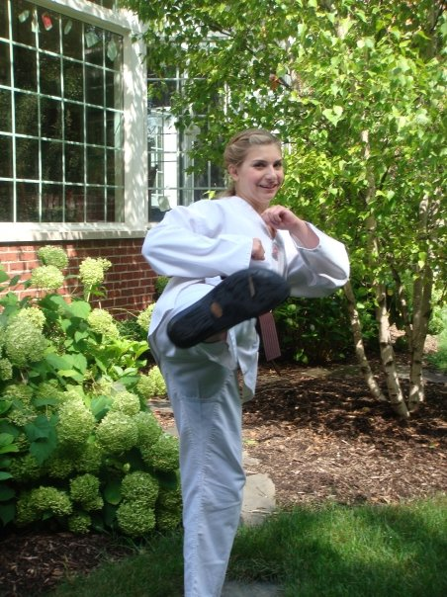
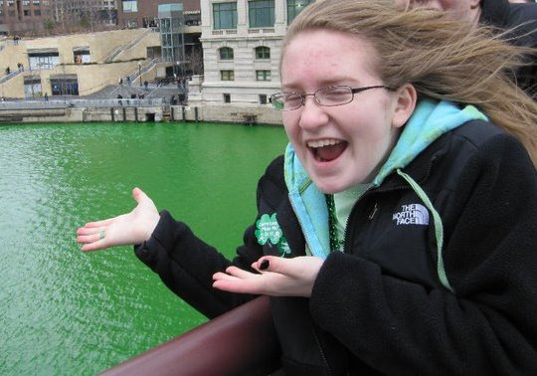
Brothers of the Week
Lauren Burke:
Is writing a fantasy fiction novel
Participates in alternative
spring break
(ASP)
Megan Dyer:
Has traveled to Germany and Australia
Favorite animal is the zebra

Slide 10
VP Communications: Lindsay Bow email: apo.oe.communications@gmail.com
Event Coordinator on APOOnline

Slide 11
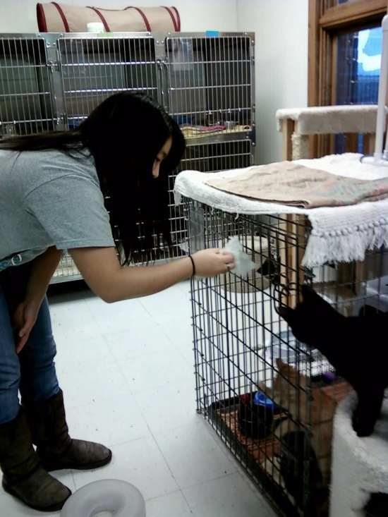
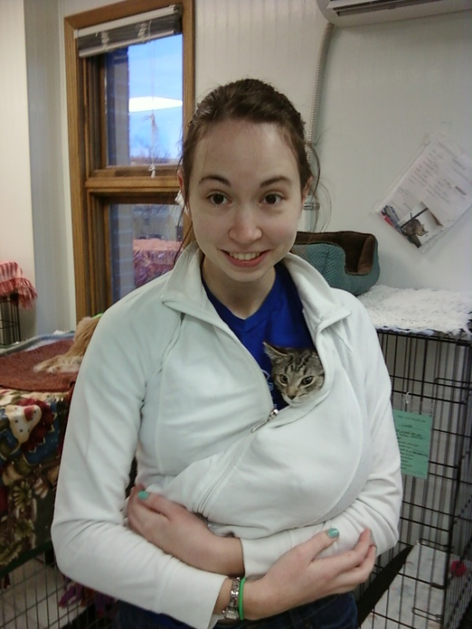
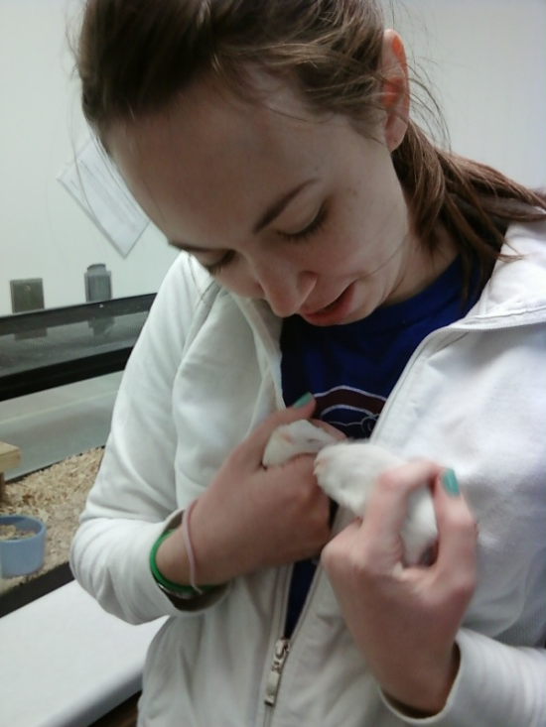
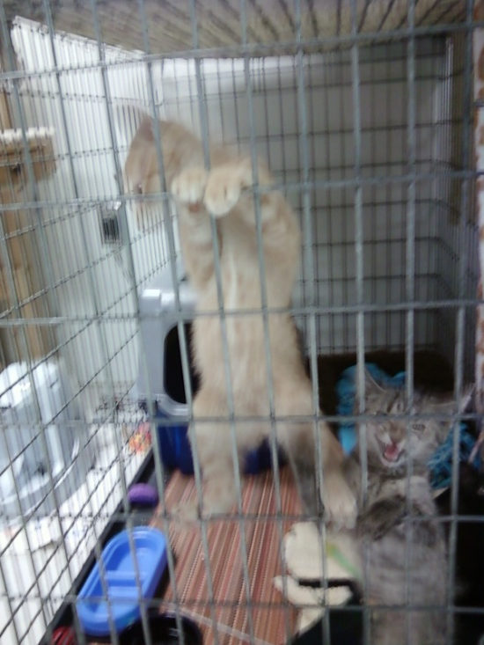
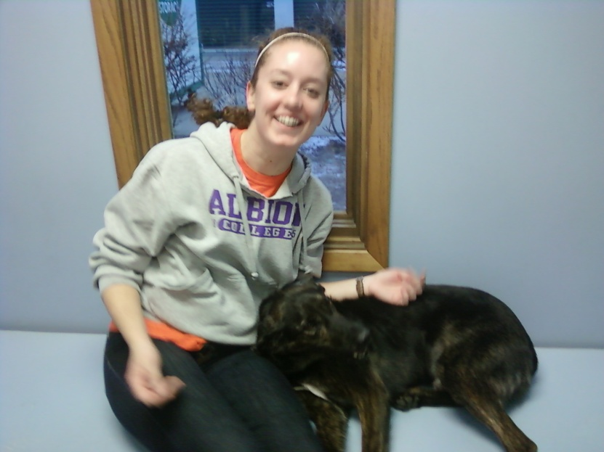
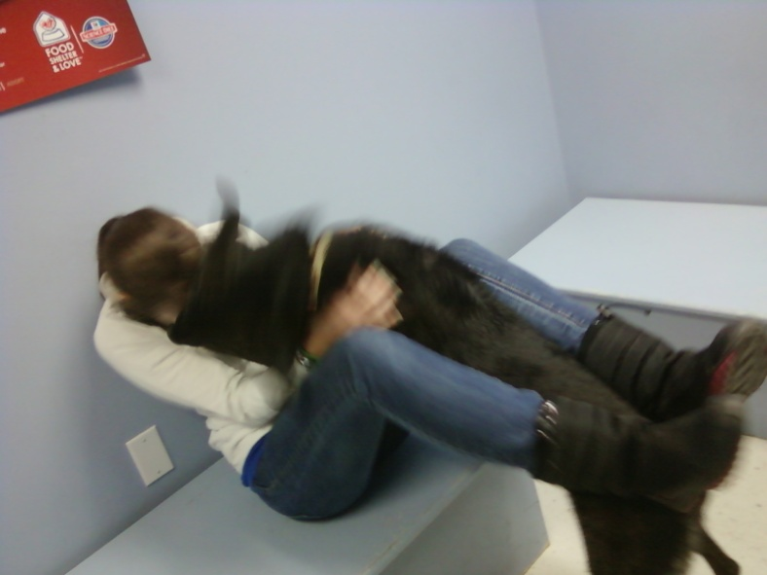
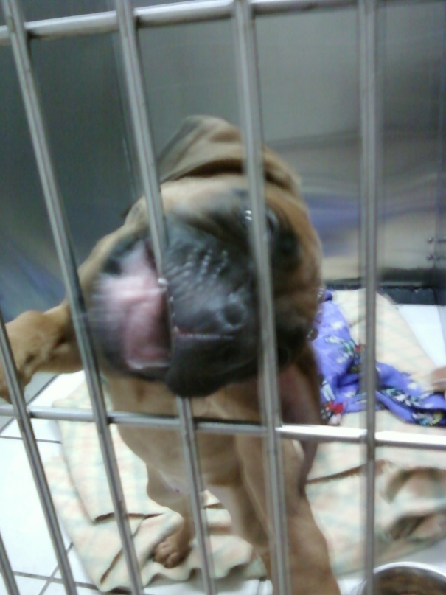
The Humane Society

Slide 12
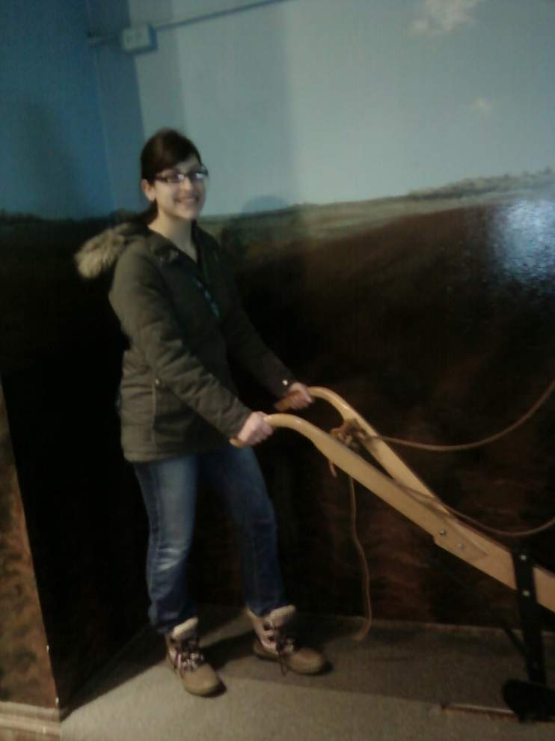
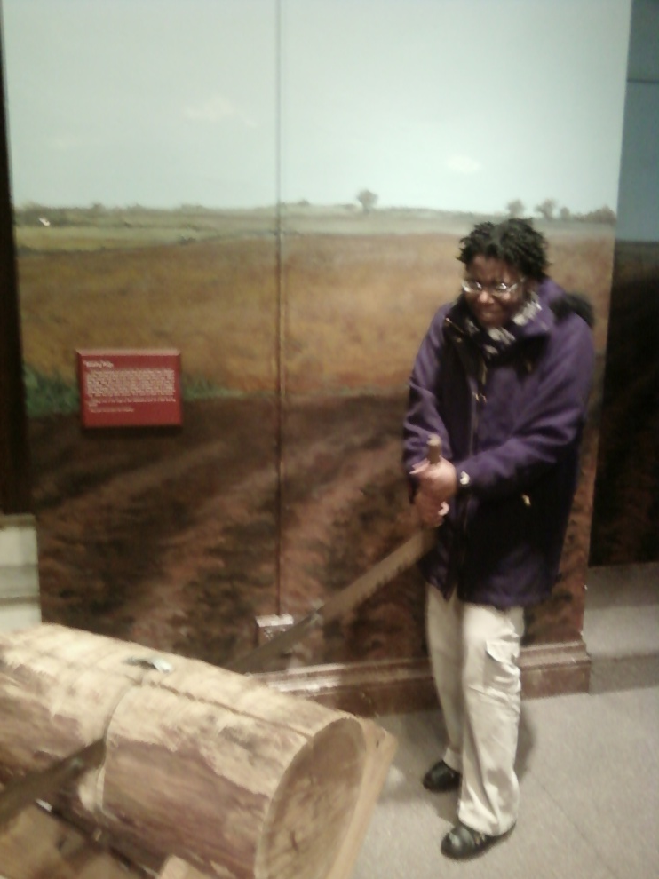
Farmer’s Market Fellowship a.k.a. Tour of the Bloomington Courthouse

Slide 13
Appointed Positions:
Student Senate Liaison - Sarah Bergman
Chaplain - Daniel Maurer
Historian - Kaitlyn Eichinger
Alumni Chair - Tiara Thomas
Webmaster - Thomas Simmons
Leadership Chair - Hayley Harroun

Slide 14
Old Business
Voted on appointed positions
Voted on associate status - Erin Brown, Maddie Cross, Emily Simpson
Approved Pledge Requirements

Slide 15
New Business
Associate - Emmi Line

Slide 16
News or Announcements

Slide 17
TOAST SONG!!

